Slide 1
VIRGINIA 4-H LIVESTOCK PROGRAMS & OPPORTUNITIES
Katherine Carter, 4-H Agent Botetourt County
and
Joi Saville, Extension Associate, APSC, VA Tech

Slide 2
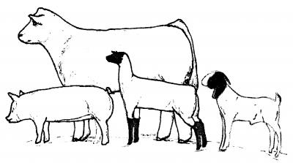
State Sponsored/Supported Events
YMQA Update
Virginia 4-H Youth Livestock Website
Use of 4-H Online
FairEntry
Local Programming
Questions

Slide 3
VT Block and Bridle Contest Weekend
February 23 – 24, 2018
4-H and FFA Events (Dual Entry Not Allowed, except for Meats)
Junior Stockmen’s (Junior and Senior Divisions)
Livestock Judging (Jr./Sr. Regular and Jr./Sr. Advanced Divisions)
Meats Evaluation (Junior and Senior Divisions)
State Contest for Both 4-H and FFA
Student Led
Two Day Event
Held at VA Tech
Multiple Competitive Opportunities
Excellent Starter Event – Large Event
Entry Fees
**Entry Deadline February 5th (approximate)

Slide 4
Virginia Beef Expo/VA Junior Beef Roundup
April 19 – 22, 2018
Youth Livestock Events (Educational/Exhibition)
Purebred and Commercial Cattle Sales
Extensive Vendor Section
Rockingham County Fairgrounds, Harrisonburg

Slide 5
State 4-H/FFA Stockmen’s Contest
Friday, April 20th, 2018
4-H and FFA Event – Not Separate Divisions
Junior Stockmen’s (Junior and Senior Divisions)
Individual and Team Awards
Winning Senior Team (competing as a 4-H Team) Advances
National 4-H Livestock Skill-a-thon Contest, Louisville
November, 2018
Held in conjunction with VA Beef Expo
Harrisonburg, VA
Entry Fees
**Entry Deadline April 1st (approximate)

Slide 6
State Youth Cattle Working Contest
Saturday, April 21st, 2018
4-H and FFA Event – Not Separate Divisions
Top Teams from Five Regional Contests
Top 10 Teams Compete
Held in conjunction with VA Beef Expo
Harrisonburg, VA
Entry Fees
5 Regional Contests held late March to Early April (Dates TBD)
Top 2 teams from each regional event advances
Requires BQA Certification

Slide 7
Virginia Junior Beef Roundup
April 20 – 22, 2018
Junior Beef Cattle Show
4-H/FFA Youth Eligible
Showmanship and Confirmation Classes
Breed Specific Show for Heifers
Commercial/Crossbred Heifer Show
Steer Show
Team Sales and Fitting Contests
Food Challenge Contest
Rockingham County Fairgrounds, Harrisonburg
Entry Fees
Entry Deadline – March 15th

Slide 8
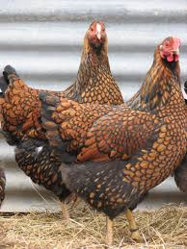
Youth Poultry Convention
April 27th, 2018
4-H and FFA Event – Dual Entry Not Allowed
Poultry Evaluation Competitions (Junior and Senior Divisions)
Individual and Team Awards
Educational Workshops in the afternoon
Rockingham County Fairgrounds - Harrisonburg, VA
Entry Fees
Winning Senior Teams from both 4-H and FFA Advance to National Contests
**Entry Deadline – March 31st (approximate)
HOSTED BY VIRGINIA POULTRY FEDERATION

Slide 9
Virginia Tech Livestock Judging Clinic
April 28th, 2018
One Day Event
4-H/FFA Youth Eligible
Live Class Evaluation
Oral Reasons Format and Practice
All Levels of Experience
Held at VA Tech
State Contest Warm-Up
Entry Fees Apply

Slide 10
State 4-H/FFA Livestock Judging Contest
June 20th, 2018
4-H and FFA Events (Dual Entry Allowed)
All 4-H Contestants Compete
FFA Finalists Compete
Junior and Senior Divisions (Reasons for Both)
Individual and Team Awards
Top Two Senior 4-H Teams Advance to National Contests
Top Two FFA Teams Advance
Held at VA Tech
Entry Fees
**Entry Deadline June 5th (approximate)

Slide 11
State 4-H All Star Livestock Judging Team
Top 10 Senior Individuals from the State 4-H Contest
Practice, Train, Compete during the Summer
Top Four Selected to Represent VA at National 4-H Contest
Excellent Opportunity for Further Advancement
Personal and Team Growth

Slide 12
Virginia Lamb & Goat Symposium
June 23rd, 2018
Educational and Exhibition Events
State Fair Model Skill-a-Thon
Showmanship and Confirmation Classes
Market Lamb and Market Goat Classes
Commercial Doe and Commercial Ewe Classes
Virginia ShowMasters Circuit Qualifying Event
Overall Shepherd Awards recognize success in and out of the ring
Held at VA Tech
Open to Exhibitors of Sheep and Goats Statewide
Entry Fees
**Entry Deadline June 10th (Approximate)

Slide 13
Virginia Tech Livestock Judging Camp
July 16th – 18th, 2018
Overnight, residence camp
4-H/FFA Youth Eligible, Open to All Ages
Live Class Evaluation
Oral Reasons Format and Practice
All Levels of Experience
Held at VA Tech
Final Day Competition
Registration Fee Applies

Slide 14
Area Youth Livestock Shows
Multi-County Specific
Species shown varies
Typically Spring Shows
Bristol Steer and Heifer Show – Early May
Central Virginia Youth Livestock Show – Early May
Chesapeake Area Livestock Show – Mid May
Fredericksburg Area Livestock Show – Mid May
Glenwood Park Livestock Expo – Early April
Piedmont Area Jr Livestock Show – Late May
Roanoke Area Jr Livestock Show – Early June

Slide 15
2018 State Fair of Virginia
Youth Livestock Shows
October 5th – 7th, 2018
Confirmation Classes
Sheep
Goats - Meat
Cattle - Beef
Hogs
Showmanship
All Species
Novice, Junior, Intermediate, Senior
Skill-A-Thon
All Species
Junior, Intermediate, Senior

Slide 16
2018 State Fair of Virginia
Youth Livestock Shows
October 5th – 7th, 2018
Nomination Process – What, When, and Where
Market Lambs, Commercial Ewes
Market Goats, Commercial Does
Market Steers/Heifers, Commercial/Crossbred Heifers
Market Hogs, Commercial Gilts, Purebred Gilts – ALL SWINE
June 15th – June 30th (Approximate) for Sheep, Goats, Cattle
Prior to August 1st for Swine
Statewide Nomination Sites for Sheep, Goats, and Cattle
On Farm, Self Nomination for all Swine

Slide 17
2018 State Fair of Virginia
Youth Livestock Shows
October 5th – 7th, 2018
Breeding Animal Shows
Purebred/Registered Ewes, Does, Gilts, Heifers
Registration Papers Required
Single Child Ownership – No family or joint ownership allowed
Scholarships
Breeding Animal Shows
Purebred/Registered Ewes, Does, Gilts, Heifers
Registration Papers Required – Shown by Age
Single Child Ownership – No family or joint ownership allowed
Market Animal Shows
Market Steers, Heifers, Hogs, Goats, Lambs – Shown by Weight
Scholarships
Sale of Champions
Sale for other market livestock

Slide 18
2018 State Fair of Virginia
Youth Livestock Shows
October 5th – 7th, 2018
Prospect Cattle Division
Shows for Steers and Heifers
Nomination is not required for animals born after January 1, 2018
Animals may be entered prior to purchase, but MUST be entered
Cattle must weigh less than 1000 pounds
Premiums, but NO SCHOLARSHIPS

Slide 19
2018 State Fair of Virginia
Youth Livestock Shows
October 5th – 7th, 2018
Showmanship
Age Calculated as of 9/30/2018
Novice: Showing at SFVA for the First Time, 12 years or under
Junior Division: Youth 12 and under
Intermediate Division: Youth ages 13 – 15 years
Senior Division: Youth ages 16 and older
**Age Breaks Also Apply to VA JR Beef Roundup and
VA Lamb & Goat Symposium

Slide 20
2018 State Fair of Virginia
Youth Livestock Shows
October 5th – 7th, 2018
Skill-A-Thon
Age Calculated as of 9/30/2018
Junior Division: Youth 12 and under
Intermediate Division: Youth ages 13 – 15 years
Senior Division: Youth ages 16 and older
Automatically entered into the species divisions that correspond to the livestock they entered
May enter ONE additional Skill-A-Thon
Non-exhibitors may enter and participate
Must Select ONE Species

Slide 21
2018 State Fair of Virginia
Youth Livestock Shows
October 5th – 7th, 2018
Premier Exhibitor Awards
Junior Division: Youth 12 and under
Intermediate Division: Youth ages 13 – 15 years
Senior Division: Youth ages 16 and older
Compilation of Showmanship, Skill-A-Thon and Single Animal Placings (Must do all three to be eligible)
Scholarships for the Top Three Individuals in each age group/species

Slide 22
2018 State Fair of Virginia
Youth Livestock Shows
October 5th – 7th, 2018
Additional State Fair Information
Per Head Entry Fee
Entry Deadline is August 15th
FairEntry System is utilized
Limited number of exhibitor passes provided
Annual YMQA Certification is Required for each Exhibitor

Slide 23
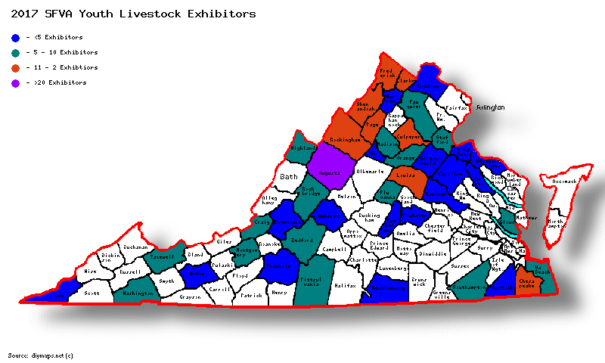
2017 SFVA Exhibitors by County

Slide 24
YMQA Update
Previous Program Developed in 2013/14
Trainer Certifications Expired
YPQA officially ending 12/31/2017
Drawbacks of Former YMQA Program
One Size Fits All
Not Species Specific
Heavy Pork/Swine Influence
Quickly Lost its “Hands-On” Design
Difficult to manage
Test Outs
Three Year Certifications
Repetitive

Slide 25
YMQA Update
Positives of Former YMQA Program
Good Place to Start
Introduced the Concept
Easy to Deliver
Identified What Works and What Doesn’t
2017 – Certified 894 youth by 41 Trainers

Slide 26
YMQA – Survey Results
Surveyed Participants & Trainers
Needs to Be More Hands On
Needs to Be Age Appropriate
Should Provide Long Term Certification
Requested more Species Specific Curriculum
Should Include More Species

Slide 27
The Future of VA’s YMQA Program
What’s Next
New Program/Curriculum Identified
Delivery Logistics - Pending
Approval and Adoption
Trainer Certification Details – Mid January
Required for ALL 2018 SFVA Youth Livestock Participants
3-5 year goal: All 4-H/FFA Youth Livestock Project members certified

Slide 28
Information and Resources
https://ext.vt.edu/4h-youth/youth-livestock.html
Youth Livestock Listserv – Joi Saville
jdyer@vt.edu
Dr. Scott Greiner – sgreiner@vt.edu
Shows/Competitive Events
Dr. Bain Wilson – tbwilson@vt.edu
Judging/Educational Events

Slide 29
VA Youth Livestock and 4-H Online
Enrollment Verification
State Stockmen’s
State Livestock Judging
Birthdate Validation
State Stockmen’s
State Livestock Judging
Integration with FairEntry
VA Jr. Beef Roundup – 2018
VA Lamb & Goat Symposium
State Fair of Virginia

Slide 30
VA Youth Livestock and 4-H Online
How Can Agents Help?
Double Check Data Accuracy
Birthdates
Addresses
Names
Future Uses
Event Entry/Registration
Contests
Clinics
Events

Slide 31
VA Youth Livestock and FairEntry.com
Fair Management and Registration Software Integrated with 4-Honline

Slide 32
VA Youth Livestock and FairEntry.com
Online Entry System
Integration with 4-HOnline
Verifies Enrollment
Provides Exhibitor Information
Total Show Management Program
Show Check-In
Class Breaks/Entry Manipulation
Results and Premium Calculations

Slide 33
VA Youth Livestock and FairEntry.com
https://fairentry.com/

Slide 34
Local Programming
Judges List – Names, Contact Info, Species
State Fair Ear Tags – County Fair Id – For Purchase
Calendar of Events – List your events

