Slide 1
Virginia Chapter of 4-H All Stars
Motto: Service
Short and Sweet Orientation for Agents
Carol Nansel, Shenandoah Co. 4-H Agent/All Star Liaison
cnansel@vt.edu
September, 2012

Slide 2
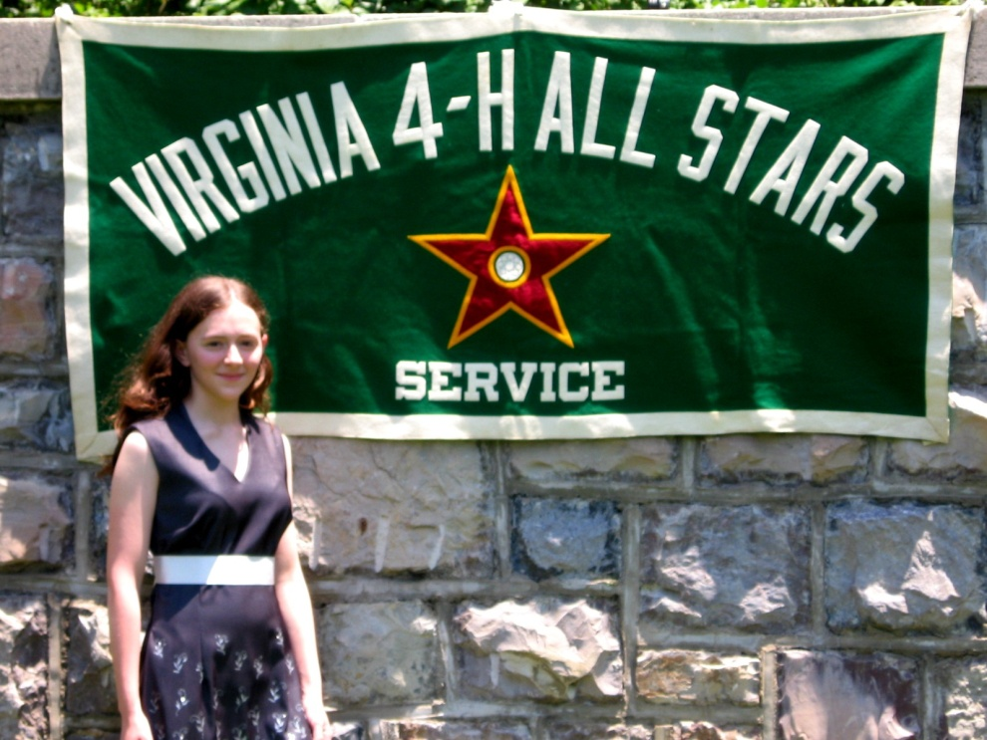
Who is or What are 4-H All Stars?
An honor/service organization (since 1923)
Highest recognition that a 4-H'er can achieve in Virginia, West Virginia, Maryland and Mississippi.
Service oriented
Volunteer operated.

Slide 3
Purpose of 4-H All Stars
To contribute to positive youth development through "service" to the 4-H program of which they are a part.
The 4-H All Star organization strives for a cooperative effort with the 4-H program in all areas.

Slide 4
Who is eligible for membership?
4-H’ers age 15 as of Jan. 1 of the initiation year, who have completed 3 years in 4-H.
Volunteers and Extension Staff who have completed 5 years of service (2 in Virginia).

Slide 5
The All Star Nomination Form (for 4-H members)
Well rounded 4-H’ers earn the most points.
Your unit program needs to be well rounded in order for your 4-H’ers to earn enough points (80 out of 116) to qualify.

Slide 6
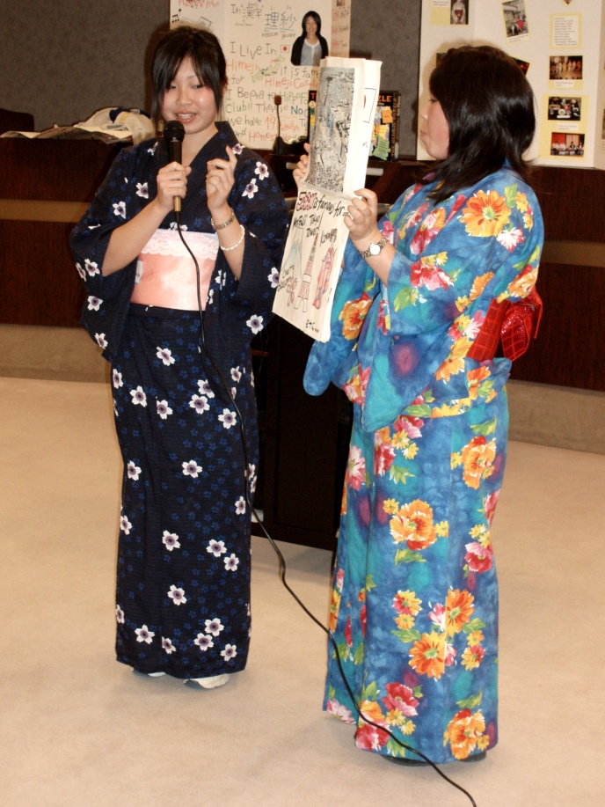
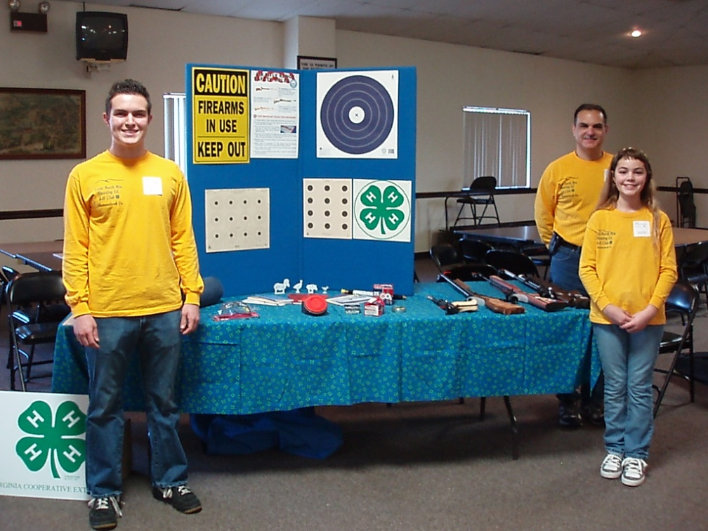
What are the basic components?
Projects and Activities (19%)
Project books
Learning experiences
Exchange programs

Slide 7
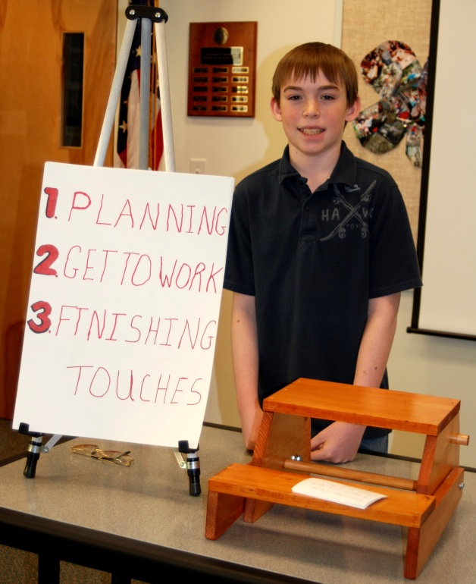
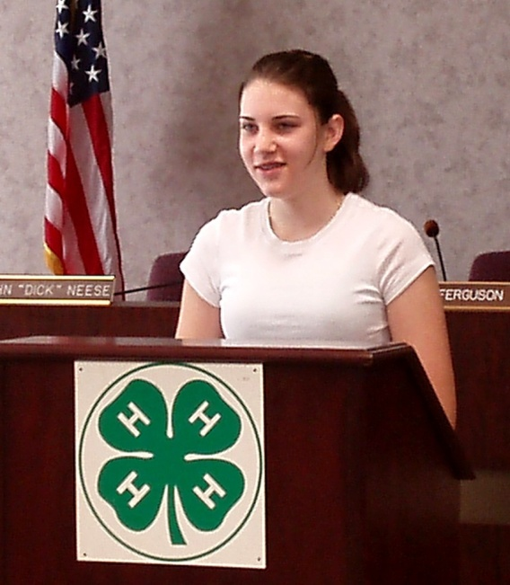
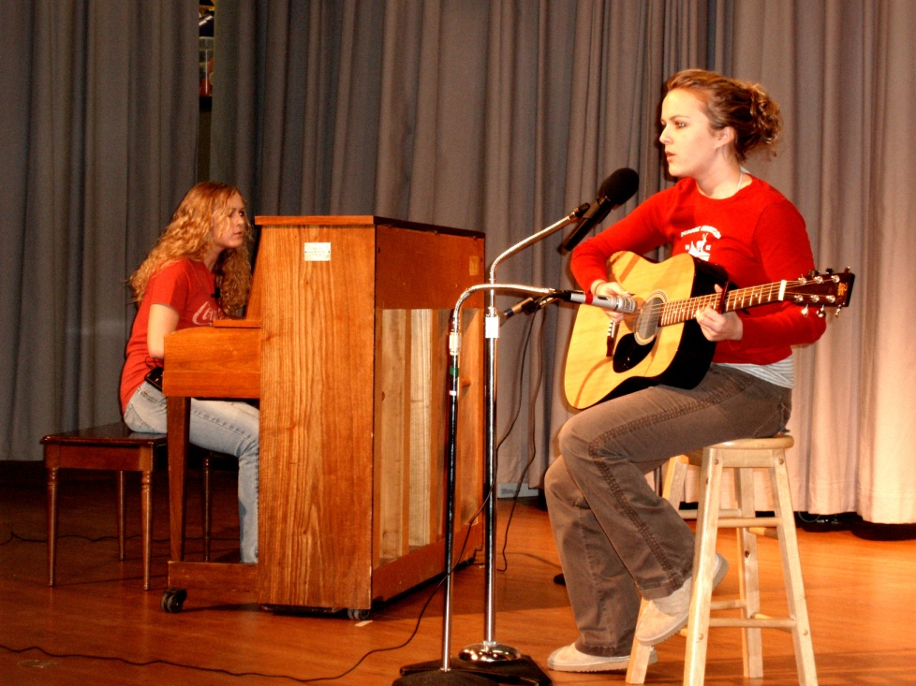
Competitive Events and Exhibits (16%)
Club, county, district, area, state, national and international

Slide 8
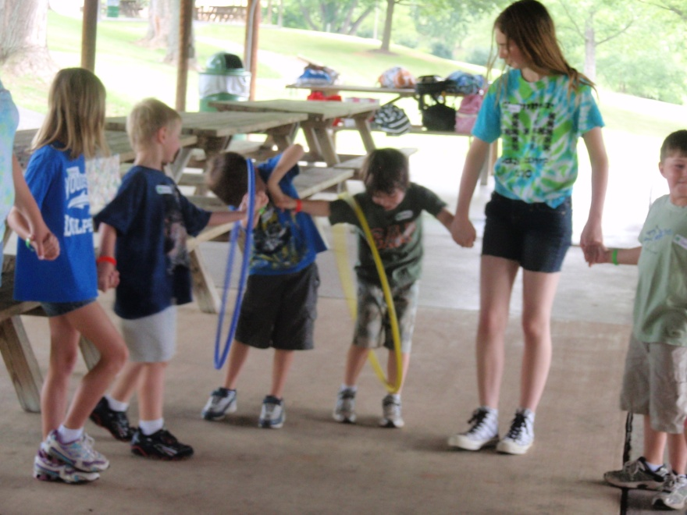
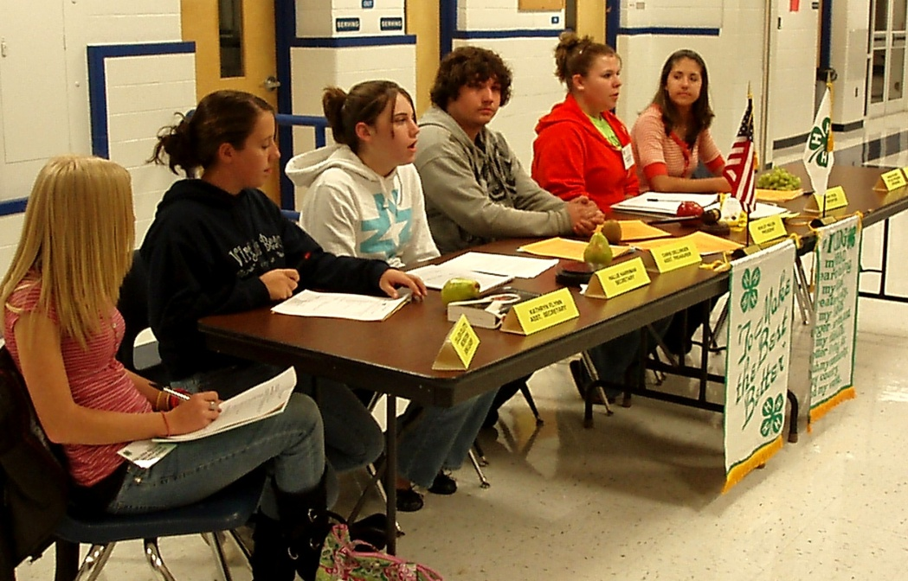
4-H Resumes/Portfolios/Interviews (3%)
Just submitting earns points
Leadership (33%)
Elected, appointed and committee work
Camp leadership
Recruitment and promotion

Slide 9
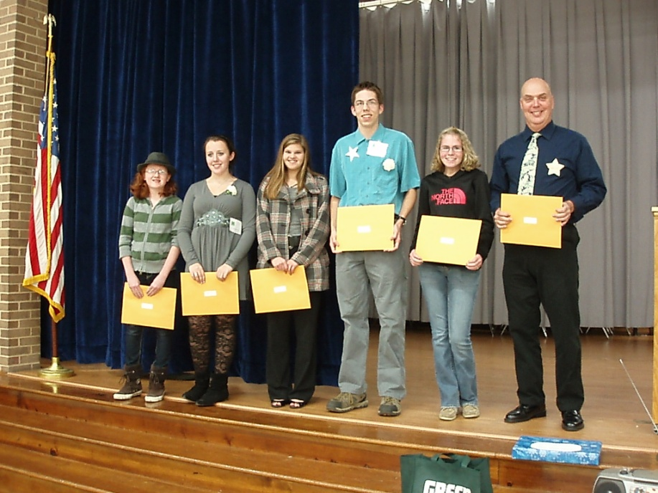
Community Service (9%)
Through 4-H and other groups
Leadership in outside organizations (6%)
Must be leadership, not membership
Recognition (14%)
Through 4-H and other groups

Slide 10
Where do I start?
Be sure you offer opportunities for 4-H’ers in the “big four” components
Leadership (33%)
Projects and Activities (19%)
Competitive Events and Exhibits (16%)
Recognition (14%)

Slide 11
Application Process
Agents share the nomination form with eligible
4-H’ers by October 1 and collect completed forms.
Schedule a meeting with All Stars in your unit to review forms and vote on them during October.
Select up to three leader nominees per unit and complete Honorary forms for them.

Slide 12
Application Process, Continued
Three All Stars and you sign forms of the accepted nominees.
Forward the nomination forms and a summary sheet to the District All Star contact by Nov. 1

Slide 13
What happens next?
A district All Star committee reviews the forms before forwarding on to the State All Star Committee. They may send them back to you for clarification.
The All Stars vote on new members during their statewide Midwinter Conference, the first weekend in February.
An acceptance letter is sent to the nominees in March.

Slide 14
What does the nominee do next?
Return the acceptance form with the initiation fee by the deadline.
Make plans to be present to be “tapped” during State 4-H Congress.
Plan to become active in their local
4-H All Star chapter after returning home!

Slide 15
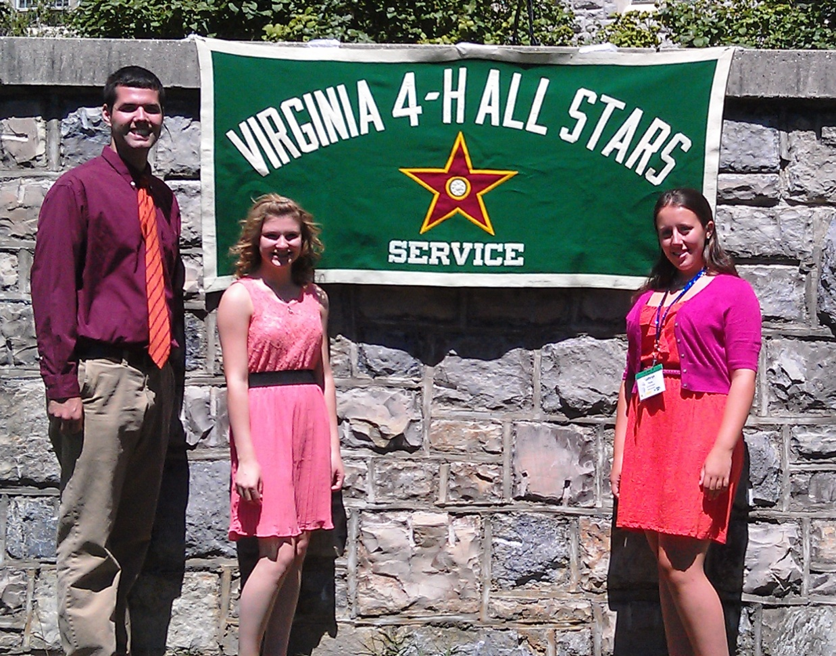
Tapping Ceremony during State 4-H Congress

Slide 16
Most FAQ before Congress
“I cannot get off work, change my vacation, miss Girls State, find a ride to VT, etc., so can I still join if I can’t be there to be tapped?”
No. You can resubmit your form again the next year. You must be present to be tapped.
Exceptions are rare and are generally made if the nominee does not have another year of eligibility. In that case, some have been tapped during the Mid-winter conference.

Slide 17
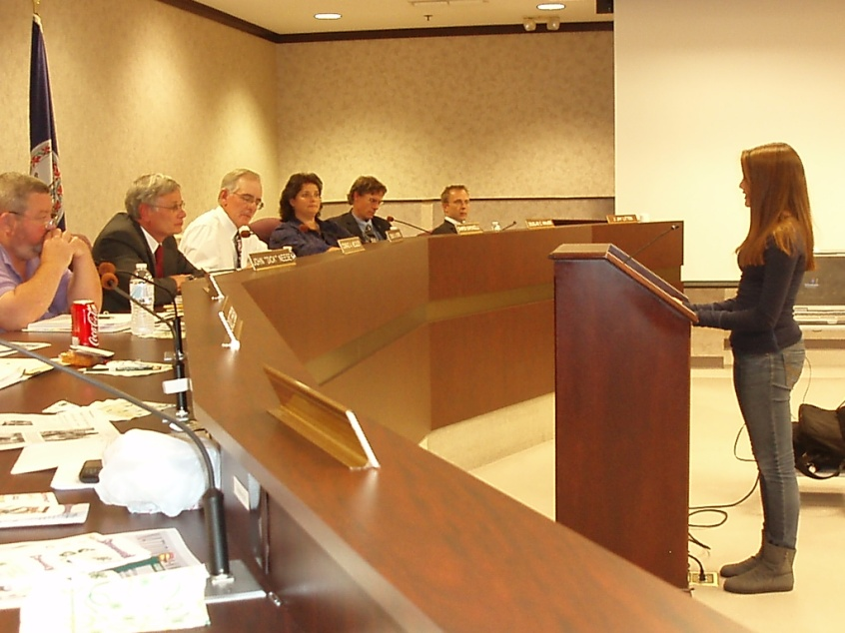
My 4-H’er has been tapped as an All Star, now what?
Get them involved in
SERVICE!
They make excellent judges, club and project leaders, coaches, mentors, 4-H speakers, donors, organizers, advocates with local government, etc.

Slide 18
How can All Stars be active beyond the Unit level?
District All Star chapter – hold office, serve on committees, plan conferences.
Statewide All Star chapter – hold office, serve on committees, attend conferences.

Slide 19
State 4-H All Star Conferences
Midwinter Conference
1st weekend in February to vote on new members
Location rotates around the state
Tapping Ceremony
During State 4-H Congress at VT
Summer Conference
Officer elections
Location rotates around the state
Interstate Conference
Location rotates between VA, WV, MD and MS

Slide 20
What is an example of local 4-H All Star Service?

Slide 21
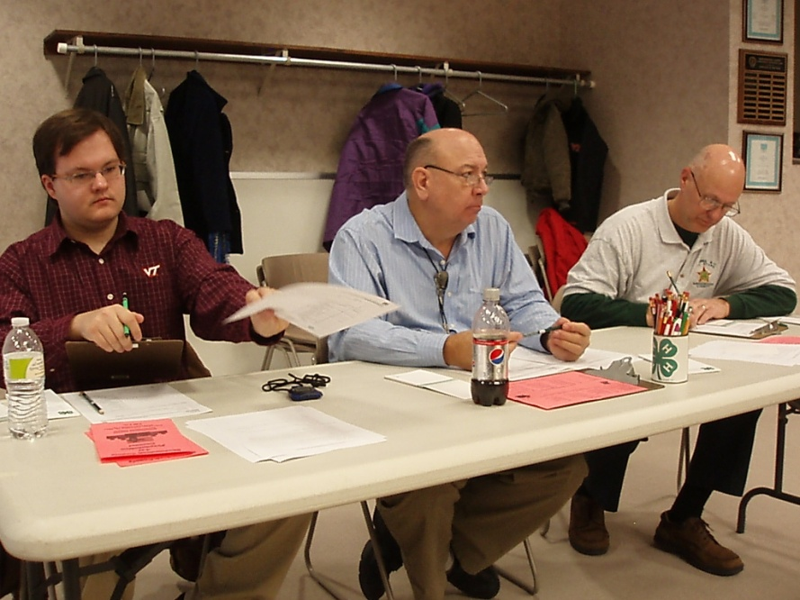
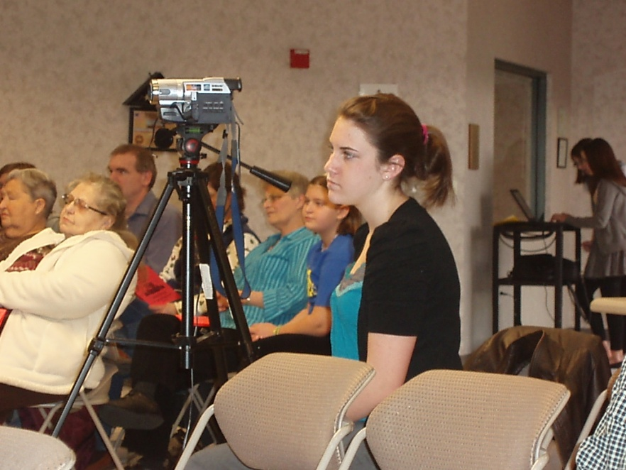
In Shenandoah County, what do the 4-H All Stars do to support the 4-H Program?
Sponsor and conduct the County 4-H Public Speaking and Presentation Contests
Contest Chair, judges, room chairs, video operators, refreshments, awards.

Slide 23
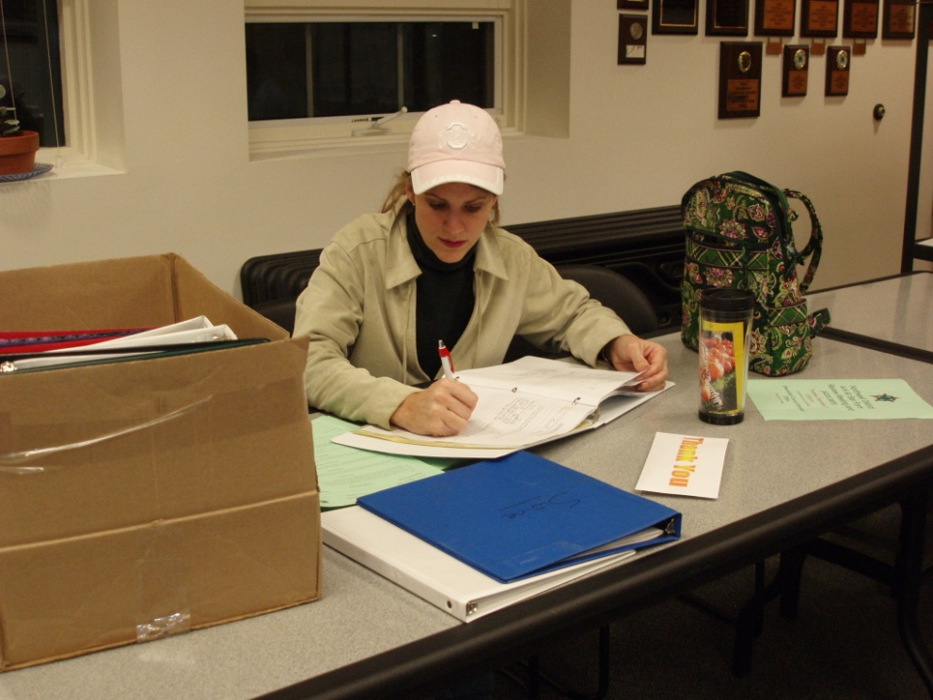
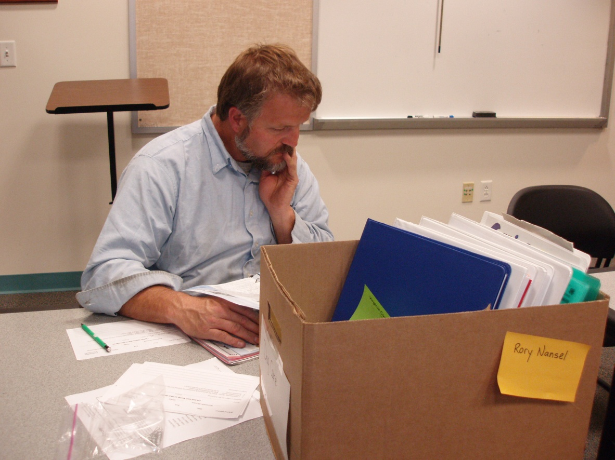
Judge completed 4-H Project books

Slide 24
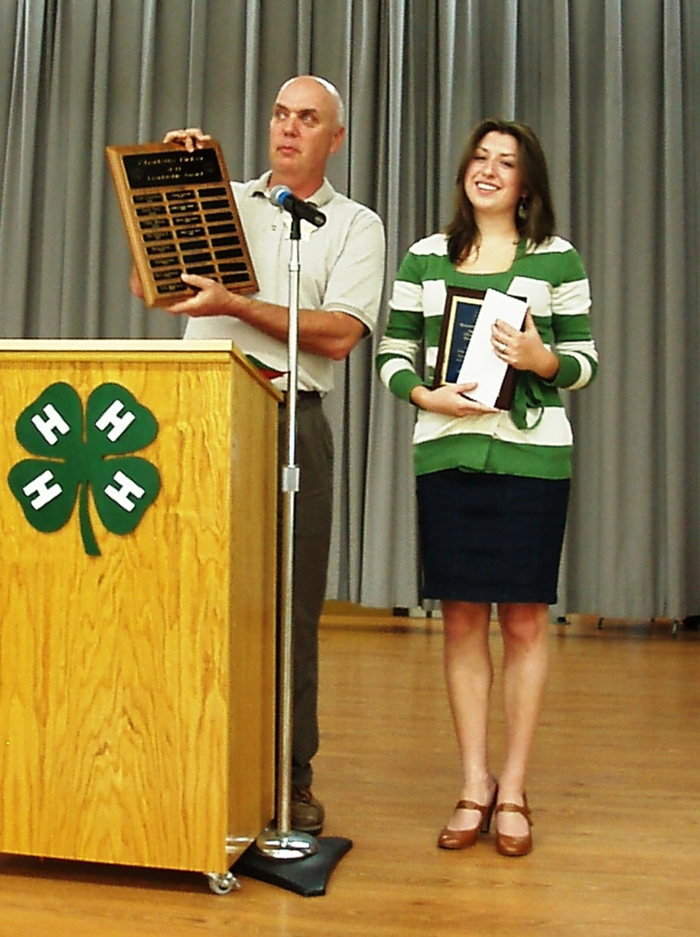
Sponsor and present awards during 4-H Achievement Night
Perform local service
– like cutting and
stacking wood for
older All Stars

Slide 25
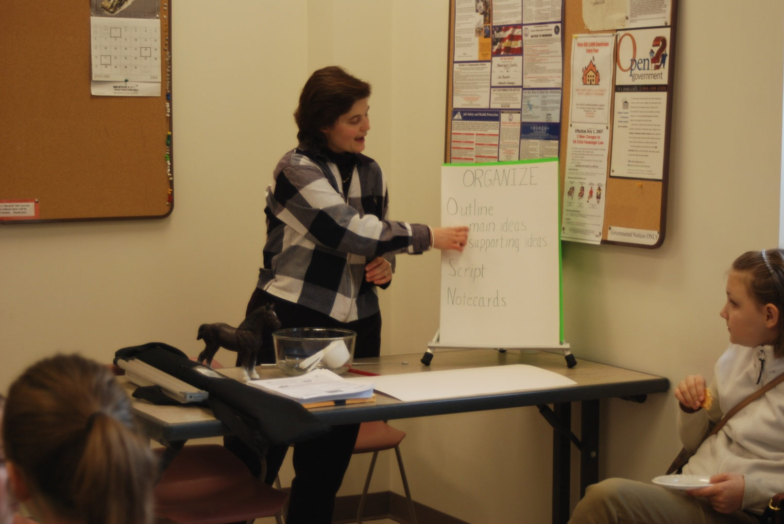
Lead local 4-H workshops
Judge at District Contests

Slide 26
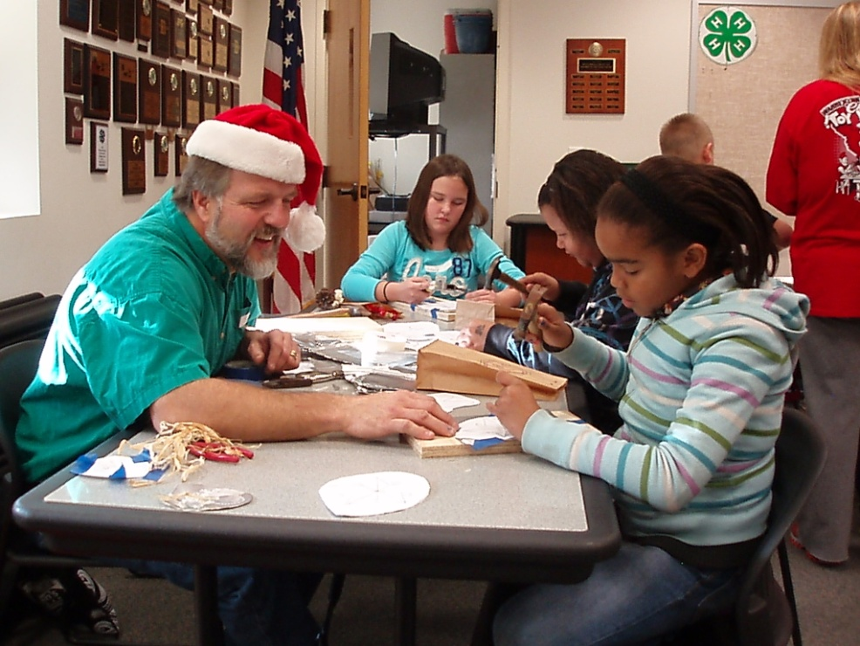
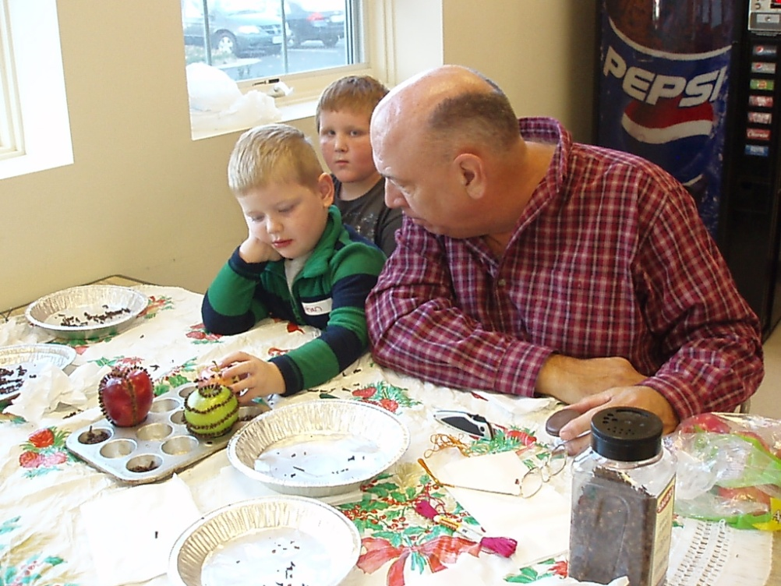
Sponsor a 4-H Ornament Making Workshop
Serve as 4-H Club Organizational and Project leaders
Mentor new leaders and new All Stars

Slide 27
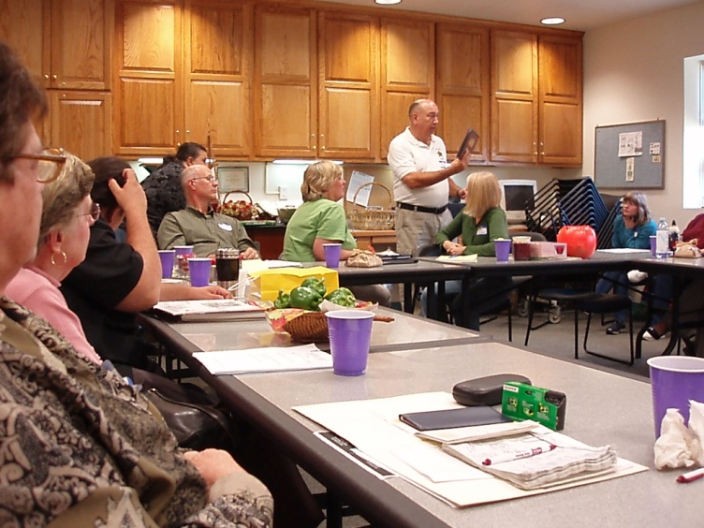
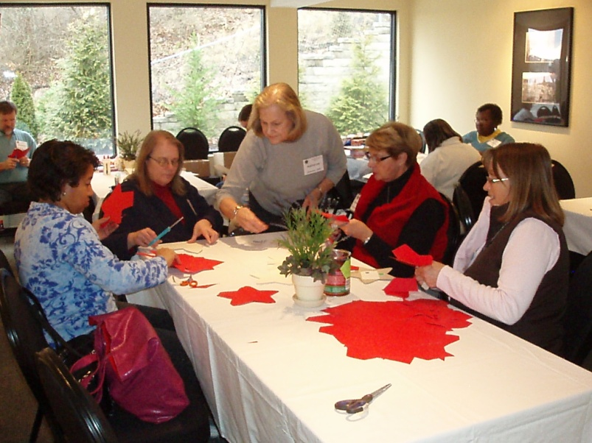
Raise money to help as needed in the local program
Speak to local decision makers on behalf of 4-H
Hold 3 yearly meetings to conduct business
Review nomination forms
Plan upcoming events
Support the District and State All Star conferences

Slide 28
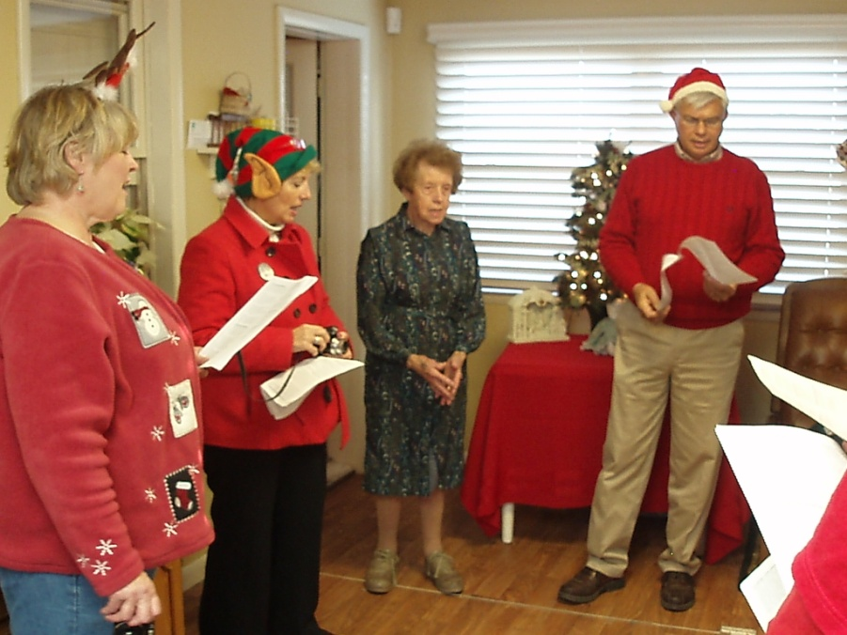
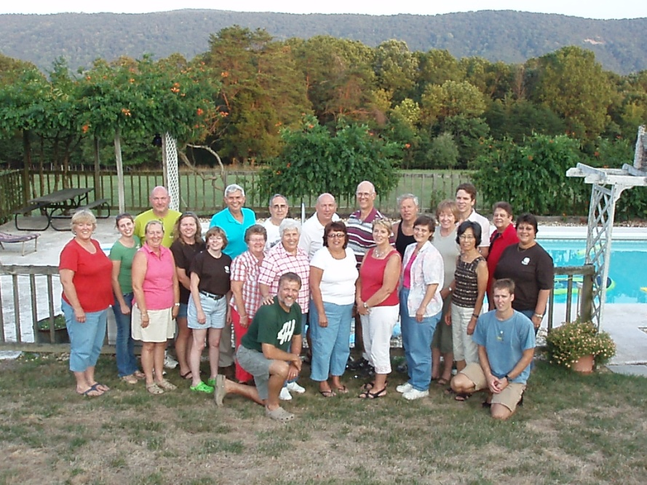
Plan fun activities to promote fellowship
Christmas caroling to shut-in All Stars
Road rally
Summer pool party/picnic
New All Star welcome picnic
Bowling

Slide 29
How do I find the All Stars in my unit?
William Thomas, All Star and former Culpeper 4-H Agent, maintains the current mailing list of Virginia 4-H All Stars
thomasvtcc64@verizon.net
Get in touch with those folks!

Slide 30
All Star Recognition
Check the All Star website for:
College scholarships (forms due Jan. 1)
Hall of Fame Award
15+ years of service
Bradshaw Service Award
Under 15 years of service
C. Dean Allen Award for Excellence
for agents
Dottie Nelson Award for Excellence in International Programs
Chapter Charter Seal Award
for active chapters

Slide 31
Questions?
http://www.4-h.ext.vt.edu/groups/allstars/4h_allstars.html
Email me anytime with questions.
cnansel@vt.edu (Shenandoah Co.)

